Slide 1


NoSQL Data Management
MODULE 4
School of Computer Science and Engineering

Slide 2
Module 4 : Document-Oriented Databases and Use Cases
Document-Oriented Databases and Use Cases : Document Databases, What Is a Document Database? Features : Consistency, Transactions, Availability, Query Features, Scaling Suitable Use Cases: Event Logging, Content Management Systems, Blogging Platforms, Web Analytics or Real-Time Analytics, E- Commerce Applications When Not to Use: Complex Transactions Spanning Different Operations, Queries against Varying Aggregate Structure.

Slide 3
Session Summary
Topics :
Document Databases
It’s Features
Suitable Use Cases
When Not to Use Document Databases

Slide 4

I. Document-Oriented Databases
It is a type of NoSQL database that stores and manages data in document format, typically using JSON, BSON, or XML.
Each document represents a single record, which contains key–value pairs, arrays, and nested objects.
Unlike relational databases (which use tables, rows, and columns), document databases are schema-less and more flexible.

Slide 5
Key Idea
Instead of splitting data across multiple tables, all related data is stored together in one document.
Ideal for applications that deal with semi-structured or unstructured data.

Slide 6

Document Structure Example
Traditional Vs Document
{"student_id": 101, "name": "Aisha Khan", "department": "CSE", "courses":
[ {"course_code":"DS101","grade": "A" },
{"course_code":"DB202","grade": "B+"}
], "contact":{"email": "aisha@example.com", "phone": "9876543210" }
}
In a relational database, this student record would require:
Students table
Courses table
StudentCourses junction table
Contact details table
With document databases, the entire profile exists as one cohesive document — easier to query and update.

Slide 7
II. Features
Consistency
Transactions
Availability
Query Features
Scaling

Slide 8
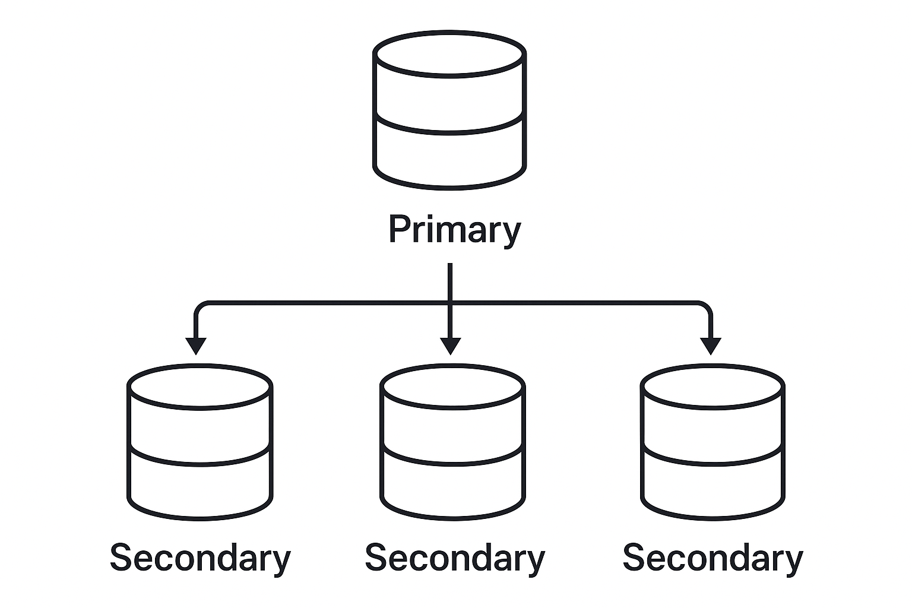
II.1. Consistency
Definition:
Consistency ensures that when data is written to the database, all users see the same data view — either the new or the old, but not a mix of both.
How It Works :
Document databases like MongoDB use replica sets
replica sets : a group of database nodes containing copies of the same data.

Slide 9
Each replica set has:
Primary node (handles all writes)
Secondary nodes (replicate data from primary)
Consistency depends on how many nodes confirm a write before it’s marked successful.

Slide 10
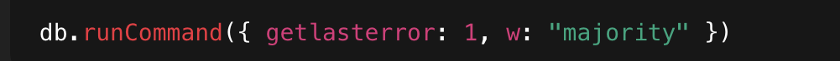
Write Consistency – 'w' Parameter
• Control level of write consistency with parameter 'w'.
• Code Example:
• 'w' defines servers that must confirm the write:
– w:1 → Only primary node (fast, less consistent)
– w:'majority' → Most nodes (balanced)
– Higher w → Stronger consistency, slower writes
Example: For 3 nodes, w: 'majority' means write completes after 2 confirmations.

Slide 11
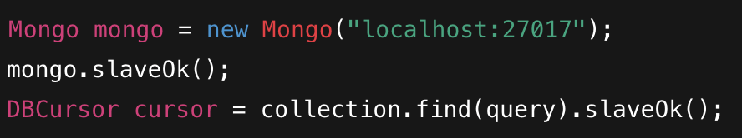
Read Consistency – Using slave0k()
• Reads by default happen from primary node.
• Use slave0k to allow reads from secondary nodes (improves performance).
Code Example:
• Can be set at connection, database, collection, or query level.

Slide 12
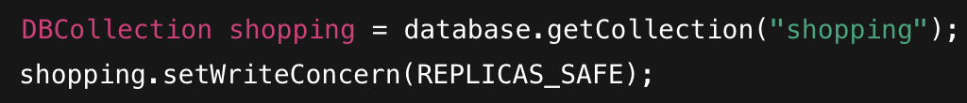
WriteConcern – Controlling Write Safety
• WriteConcern defines how safe a write operation should be.
• Ensures writes are replicated or written to disk before confirming.
Code Example:
Provides control over reliability of write operations.

Slide 13
Trade-off
Strong Consistency → Slower (waits for all replicas)
Eventual Consistency → Faster, but temporary lag in updates.

Slide 14
Trade-Off Between Consistency & Performance
Setting | Effect | Use Case
Low w / No WriteConcern | Faster writes, risk of data loss | Logging, analytics
High w / REPLICAS_SAFE | Safer writes, slower performance | Financial, order systems
slaveOk = true | Faster reads, may return old data | Reporting, analytics
slaveOk = false | Strong consistency | Real-time transactions

Slide 15
Example
An e-commerce site updates a product price:
Strong consistency ensures all customers see the new price.
Eventual consistency allows some customers to briefly see the old price before replicas sync.

Slide 16
Consistency in a NutShell
• Consistency is configurable in MongoDB.
• Replica Sets balance between speed and reliability.
• WriteConcern → Controls write safety.
• slaveOk → Controls read flexibility.
• Choose based on business needs:
– Critical apps → High consistency
– Analytical apps → High performance

Slide 17
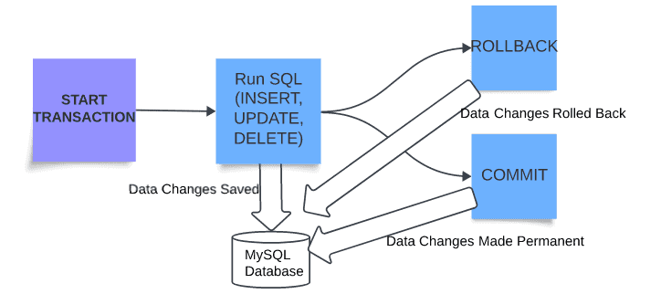
II.2. Transactions
• Traditional RDBMS supports multi-operation transactions.
• You can commit or rollback changes made across multiple tables.
• Ensures ACID properties: Atomicity, Consistency, Isolation, Durability.

Slide 18
Transactions in NoSQL Databases
• NoSQL databases like MongoDB differ from RDBMS.
• Writes either succeed or fail — no rollback option.
• Multi-document transactions generally not supported.
• Single-document writes are atomic (all-or-nothing).
Example: A JSON document write is treated as one complete operation.

Slide 19
Multi-Operation Transactions
• Some NoSQL databases (e.g., RavenDB) support multiple-operation transactions.
• MongoDB (pre–4.0) did not support multi-document transactions.
• Newer versions (≥4.0) support transactions within a single replica set.

Slide 20
Role of WriteConcern
MongoDB offers WriteConcern for controlling write safety.
It defines how many nodes must confirm a write before success.
Example levels:
WriteConcern.NONE → Fastest, no confirmation (low safety)
WriteConcern.REPLICAS_SAFE → Write confirmed by primary + at least one secondary
Example Use:
Log entries → Use WriteConcern.NONE (performance-focused)
Orders → Use WriteConcern.REPLICAS_SAFE (safety-focused)

Slide 21
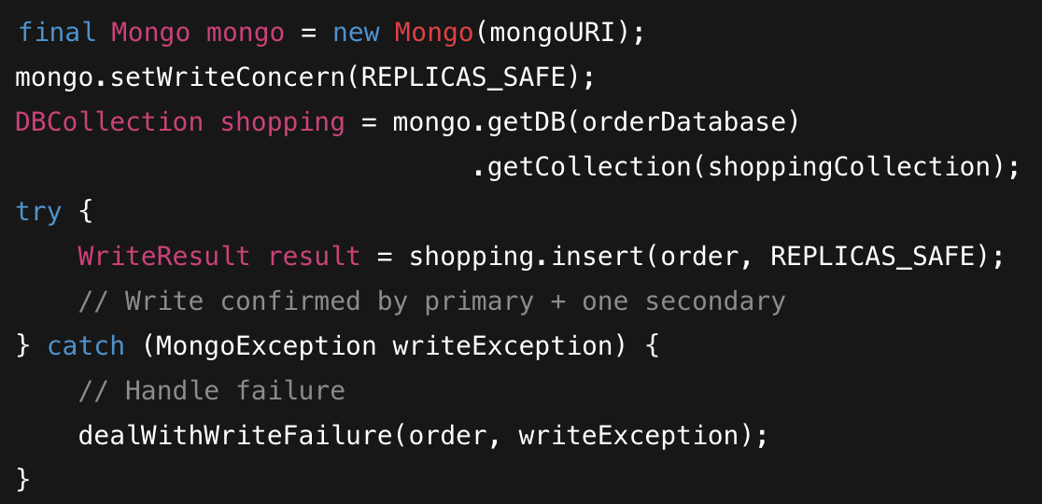
Example Code – Using WriteConcern
Explanation:
Ensures the order is stored on at least two nodes.
Prevents data loss during node failure.

Slide 22
Example
If a banking app stores each account as a document:
Transferring money between two accounts (two documents) → multi-document transaction.
Updating one account’s balance → single-document atomic operation.
Use Case
Financial apps (require strict consistency)
Inventory systems (avoid double deduction)

Slide 23
Transaction in a NutShell
MongoDB supports atomic single-document transactions.
For multi-document consistency, use WriteConcern or transactions in modern versions.
WriteConcern provides granular control over write reliability.
Choose appropriate settings based on:
Data criticality
Performance requirements

Slide 24
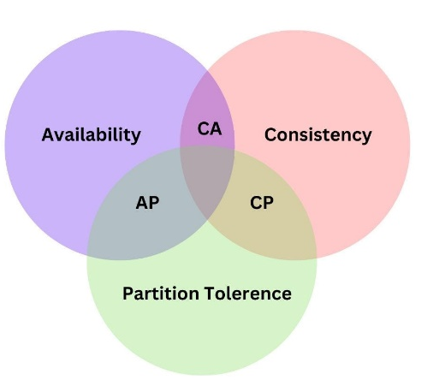
II.3. Availability
Availability ensures the database remains accessible even during failures.
Based on CAP Theorem:
You can have only two of the three:
Consistency
Availability
Partition Tolerance
Document databases often favour Availability + Partition Tolerance.

Slide 25
How Availability is achieved
Document databases (e.g., MongoDB, CouchDB, RavenDB) use Replication.
Data is replicated across multiple nodes — so if one fails, others serve data.
Uses Master-Slave (Primary-Secondary) setup:
Master (Primary) node handles all writes.
Slave (Secondary) nodes replicate data from primary asynchronously.

Slide 26
MongoDB Replica Sets
MongoDB ensures high availability through Replica Sets.
Replica Set: Group of nodes with one primary and multiple secondaries.
Replication is asynchronous – secondaries copy data from the primary.
Automatic Election:
When the primary fails, the remaining nodes vote to elect a new primary.
Clients automatically redirect traffic to the new primary.
Example: If Node A fails, Node B becomes the new primary automatically.

Slide 27
How it Works….
In a replica set, there are two or more nodes participating in an asynchronous master-slave replication.
The replica-set nodes elect the master, or primary, among themselves.

Slide 28
Assuming all the nodes have equal voting rights, some nodes can be favoured for being closer to the other servers, for having more RAM
Users can assign a priority—a number between 0 and 1000—to a node.

Slide 29
All requests go to the master node, and the data is replicated to the slave nodes.
If the master node goes down, the remaining nodes in the replica set vote among themselves to elect a new master;

Slide 30
All future requests are routed to the new master, and the slave nodes start getting data from the new master.
When the node that failed comes back online, it joins in as a slave and catches up with the rest of the nodes by pulling all the data it needs to get current.

Slide 31
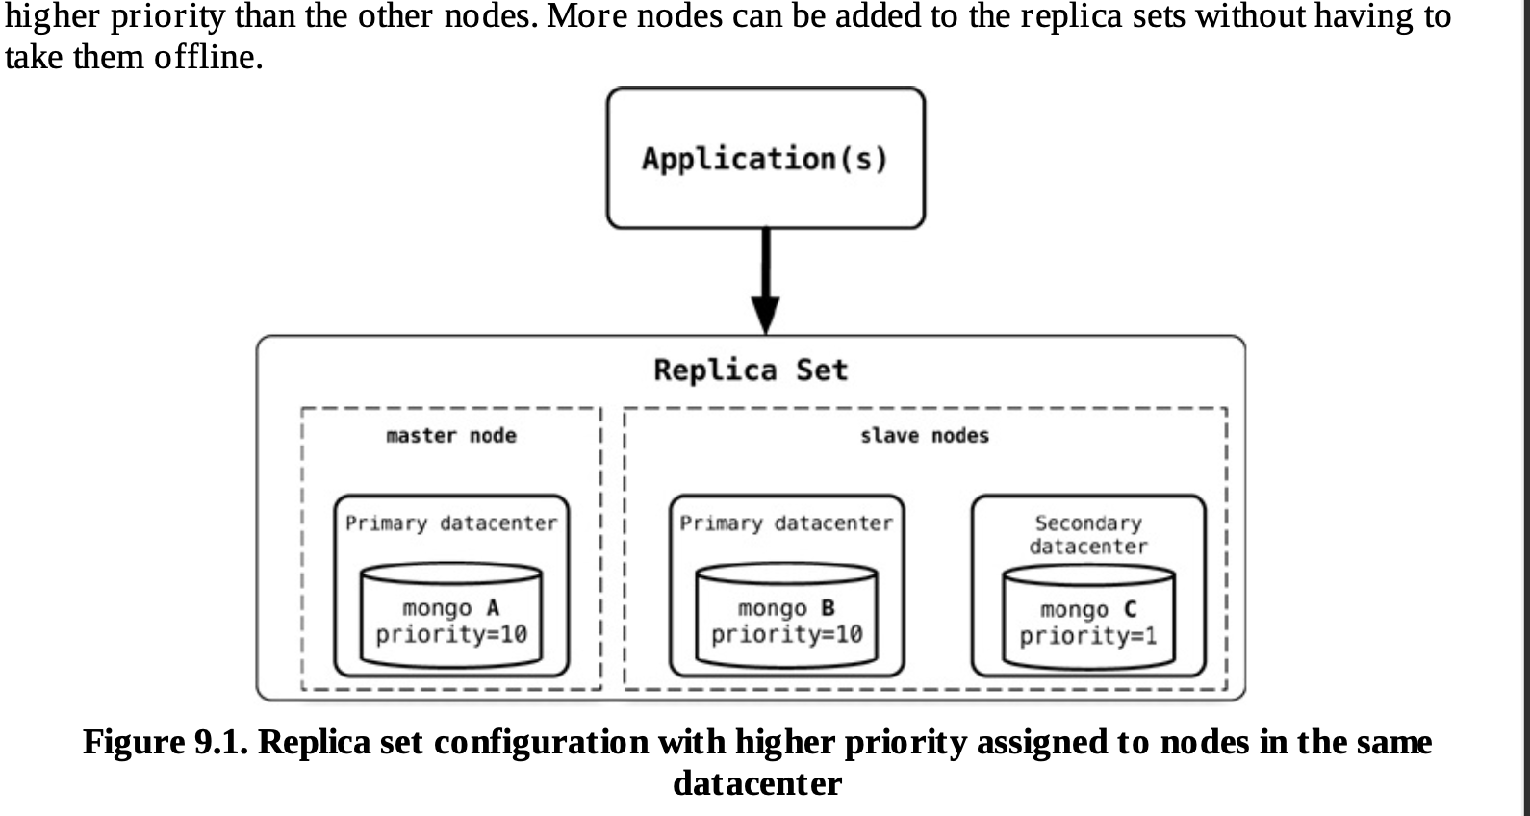
Fig: Replica set configuration with higher priority assigned to nodes in the same data center

Slide 32
We have two nodes, mongo A and mongo B, running the MongoDB database in the primary data-center, and mongo C in the secondary datacenter.
If we want nodes in the primary data center to be elected as primary nodes, we can assign them a higher priority than the other nodes.
More nodes can be added to the replica sets without having to take them offline.

Slide 33
Application Connectivity
The application connects to any one node in the replica set.
The database automatically discovers all other nodes.
If the current primary fails:
The driver connects to the new primary automatically.
No manual intervention needed for failover or node management.

Slide 34
Benefits of Replica Sets
Feature | Purpose / Benefit
High Availability | Database remains online during node failures
Data Redundancy | Copies of data across multiple nodes
Automatic Failover | No manual switch required
Read Scaling | Read operations can be distributed to secondaries
Server Maintenance | Perform updates without downtime
Disaster Recovery | Secondary nodes act as backups

Slide 35
Availability in A NutShell
Availability is maintained using replica sets and automatic failover.
Priority-based elections ensure primary resides in desired location.
Applications remain connected during failovers—no manual action needed.
Provides data safety, uptime, and seamless maintenance.

Slide 36
II.4. Query Features
Document databases offer powerful and flexible querying options.
Unlike key-value stores, they allow you to query within documents — not just by key.
Bring querying closer to the RDBMS model (like SQL).

Slide 37
MongoDB Example
MongoDB uses a JSON-based query language.
Supports SQL-like operations:
$gt: greater than
$orderby: sorting
$explain: execution plan for optimization
Queries can be combined and nested easily.

Slide 38
SQL vs MongoDB Query Comparison
Requirement | SQL Query | MongoDB Query
Retrieve all orders | SELECT * FROM order; | db.order.find()
Orders for one customer | SELECT * FROM order WHERE customerId = "883c2c5b4e5b"; | db.order.find({"customerId":"883c2c5b4e5b"})
Specific fields | SELECT orderId, orderDate FROM order WHERE customerId="883c2c5b4e5b"; | db.order.find({customerId:"883c2c5b4e5b"},{orderId:1,orderDate:1})

Slide 39
Views and Aggregation
Systems like CouchDB support views (materialized or dynamic).
MapReduce is used for aggregation tasks like counting reviews or finding average ratings.
Materialized views store precomputed results for faster retrieval.

Slide 40
Advantages
Rich querying (like RDBMS)
Nested data queries
JSON-based syntax (human-readable)
Example
In an e-commerce platform:
To get the average rating of a product, use a MapReduce view.

Slide 41
Query Features in a NutShell
Document databases allow rich querying similar to SQL but more flexible.
CouchDB: Uses Views (materialized or dynamic) + MapReduce.
MongoDB: JSON-based queries, simple syntax, supports nested document querying.
Benefits:
Simplifies code (no complex joins).
Improves performance using materialized views.
Works great for real-time web and analytics apps.

Slide 42
II.5. Scaling
Scaling → Expanding database capacity without upgrading hardware.
Goal: Handle more read/write load efficiently.
Achieved by:
Adding more nodes (horizontal scaling)
Distributing data across nodes

Slide 43
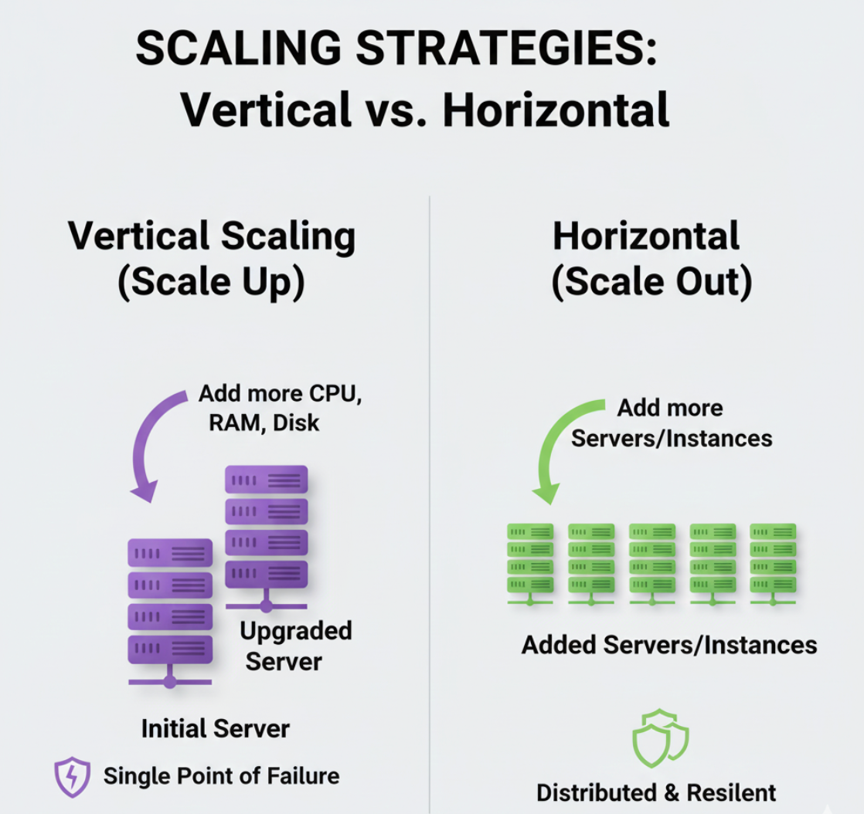

Slide 44
Types of Scaling
Type | Purpose | Technique
Read Scaling | Handle increased read requests | Add read replicas/slaves
Write Scaling | Handle increased write requests | Use sharding

Slide 45
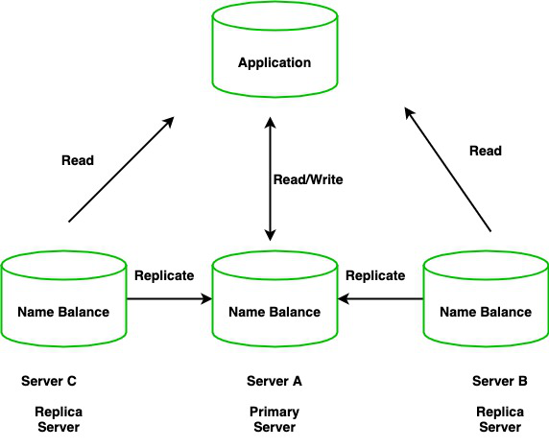
Read Scaling – Using Replica Sets
Add more read slaves (secondary nodes) to handle higher read loads.
Reads can be directed to secondaries using slave0k flag.
New node joins automatically, syncs with existing data, and serves reads.
No downtime → Continuous availability.

Slide 46
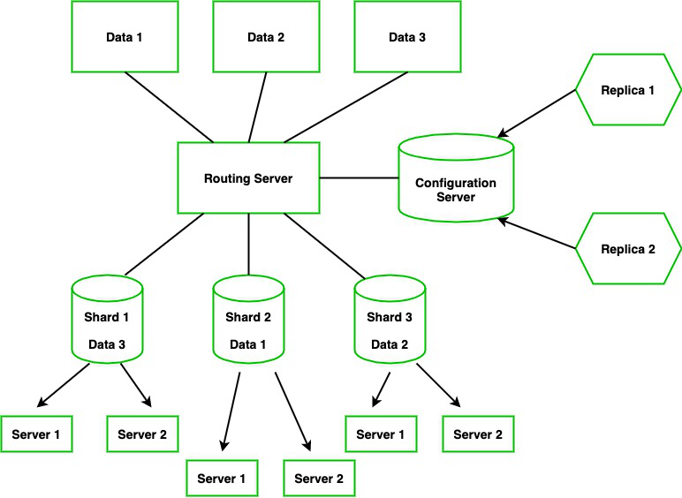
Write Scaling – Sharding
Sharding = Splitting data into smaller chunks (shards) stored across nodes.
Similar to partitioning in RDBMS, but shards are on different machines.
MongoDB manages:
Data distribution
Load balancing
Dynamic rebalancing

Slide 47
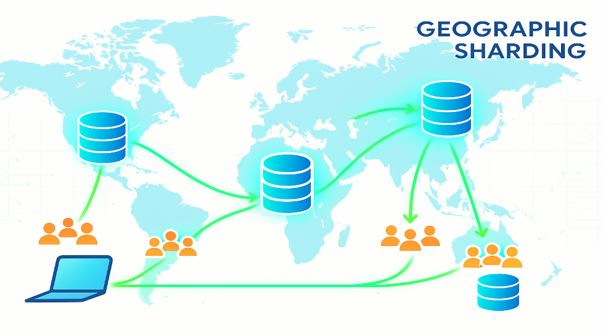
Importance of Shard Key
The shard key determines how data is divided across nodes.
Choose shard key carefully to maintain balance and performance.
Example:
By customer location:
East Coast → Shards in East
West Coast → Shards in West
Helps localize data and reduce latency.

Slide 48
Key Benefits of Scaling in MongoDB
Feature | Benefit
Read Replication | Handles heavy read loads
Sharding | Handles heavy write loads
Zero Downtime | Nodes added dynamically
Data Locality | Shards closer to users
High Availability | Continuous service through replica sets

Slide 49
Scaling in a NutShell
MongoDB achieves scaling via replication (reads) and sharding (writes).
Horizontal scaling → add nodes, not hardware.
Ensures high performance, availability, and zero downtime.
Proper shard key design is crucial for efficiency and load balance.

Slide 50
Feature | Description | Example | Benefit
Consistency | Ensures same view of data across replicas | Price update in store | Reliable reads
Transactions | Multi-operation atomic updates | Money transfer | Data integrity
Availability | System stays up despite failures | Failover to replica | Fault tolerance
Query Features | Flexible, JSON-style queries | Find all users with age > 30 | Powerful filtering
Scaling | Handle large data/load via sharding/replication | Distribute users across servers | Better performance

Slide 51
III. Suitable Use Cases
Event Logging
Content Management Systems
Blogging Platforms
Web Analytics or Real-Time Analytics
E- Commerce Applications

Slide 52
III.1. Event Logging
Event Logging → Recording activities or actions across applications.
Need: Enterprises have many apps generating diverse event data.
Document Databases are ideal because they:
Handle changing event structures (schema flexibility).
Serve as a centralized store for all events.
Allow easy querying across multiple event types.

Slide 53
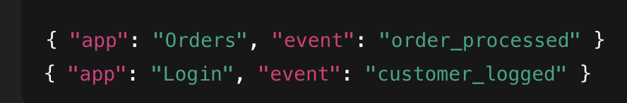
Scaling & Advantages
Sharding:
Distribute data by application name or event type
Benefits:
📈 Scalable for large log volumes
🧩 Handles different data formats
⚡ Enables fast queries & real-time analysis
🗄️ Central storage for all enterprise events
e.g., order_processed → Shard 1,
customer_logged → Shard 2

Slide 54
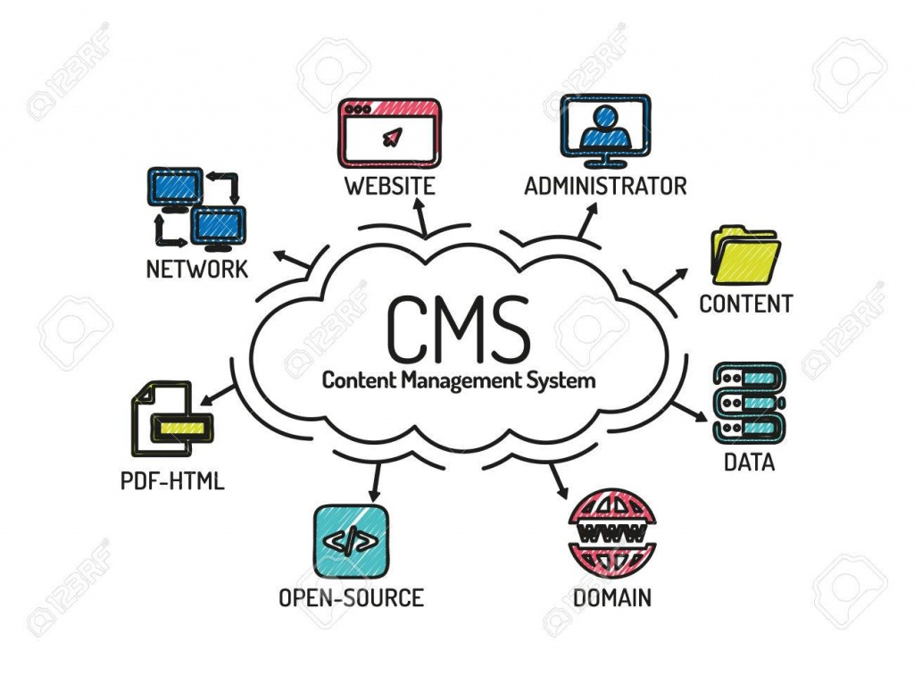
III.2. Content Management Systems
Flexible Structure:
No predefined schema → easy to store and update diverse content.
Uses JSON documents, making data simple and human-readable.

Slide 55
Perfect Fit For:
📰 Content Management Systems (CMS)
💬 User Comments & Discussions
👤 User Registrations & Profiles
🌐 Web Publishing Applications
Example: A JSON document can store user details, comments, and posts — all in one flexible structure.

Slide 56
Key Advantages
✅ Handles frequent content updates without redesigning schema.
✅ Supports dynamic web content and scalable user data.
✅ Ideal for modern, web-facing applications requiring flexibility and speed.
“Document databases are the backbone of dynamic, content-driven web applications.”

Slide 57
III. 3. Blogging Platforms
Blogs have flexible and evolving structures (titles, tags, comments, media, etc.).
No fixed schema → easily adapt to new fields like “featured image” or “reading time”.
JSON-based storage fits perfectly for storing post content and metadata.

Slide 58
Benefits for Blogging Platforms
🧩 Schema Flexibility: Add new fields (likes, shares, tags) anytime.
⚡ Performance: Fast reads/writes for posts and user comments.
🌍 Scalability: Handles thousands of posts and comments via sharding.
💬 Embedded Data: Comments, tags, and author info can live inside the same document.
🔄 Easy Updates: Modify content or structure without schema migration.

Slide 59
III. 4. Web Analytics or Real-Time Analytics
Real-Time Data Handling:
Can efficiently store and update metrics like page views and unique visitors.
Flexible Updates:
Only parts of a document can be updated → no need to rewrite the entire record.
Schema Flexibility:
New metrics (e.g., “time spent,” “clicks,” “shares”) can be added anytime without schema changes.

Slide 60
Ideal Use Cases:
📊 Website Analytics: Track page views, unique visitors, session duration.
🛍️ E-commerce Insights: Monitor live sales, cart abandonment, conversion rates.
📱 App Performance Tracking: Record user interactions and API response times.
⚙️ IoT Monitoring: Collect sensor data and update device metrics in real-time.

Slide 61
III. 5. E- Commerce Applications
Why Document Databases?
E-commerce data (products, customers, orders) varies in structure.
Schema flexibility allows easy addition of new fields (e.g., offers, reviews, images).
No downtime or costly migrations when requirements change.

Slide 62
Use Cases
🛒 Product Catalog Management: Each product can have unique attributes (color, size, brand, specs).
📦 Order Management: Orders can embed customer info, payment details, and item list in one document.
👤 Customer Profiles: Store purchase history, preferences, and wish lists dynamically.
💬 Reviews & Ratings: Embedded comments and feedback stored within product documents.

Slide 63
IV. When Not to Use Document Databases

Slide 64
IV.1. Complex Transactions Spanning Different Operations
Challenge:
Document databases are not ideal for atomic, cross-document transactions.
They are designed for single-document atomicity, not multi-document operations.
Impact:
Applications needing strict transactional consistency (e.g., banking, accounting systems) may face limitations.
Exception:
Some document databases like RavenDB provide limited support for multi-document transactions.

Slide 65
IV.2. Queries against Varying Aggregate Structure
Flexible Schema Challenge:
Document databases do not enforce a fixed schema — data is stored as application-specific entities.
When aggregate design changes frequently, query structures must also change.
Problem:
Ad hoc queries become complex as aggregate structures vary.
Similar to an RDBMS where join tables keep changing.

Slide 66
Workaround:
Data may need to be stored at the lowest level of granularity (normalized form).
But this defeats the purpose of using a document database.
“When aggregate structures change often, querying becomes inefficient — making document databases less suitable.”

Slide 67


